Slide 1
P2 – Group 1
Gabriel Klein, Grant Muse, Jesse Sabbath

Slide 2
Goals
Create a Spark application to process Covid data
Discover trends in the data and how we can use these trends to make useful decisions

Slide 3
Tech Stack
Scala 2.11.12
Hadoop 3.2
Spark 3.1.2
sbt 1.5.5
IntelliJ
Excel
GitHub

Slide 4





GitHub
https://github.com/GabrielMichaelKlein/p2-Group-1

Slide 5
Trends We Explored
Covid cases/deaths over time by state in US
Covid cases/deaths by population per state in US
Death to Case ratios by country

Slide 6

Covid Cases/Deaths Over Time (US)

Slide 7
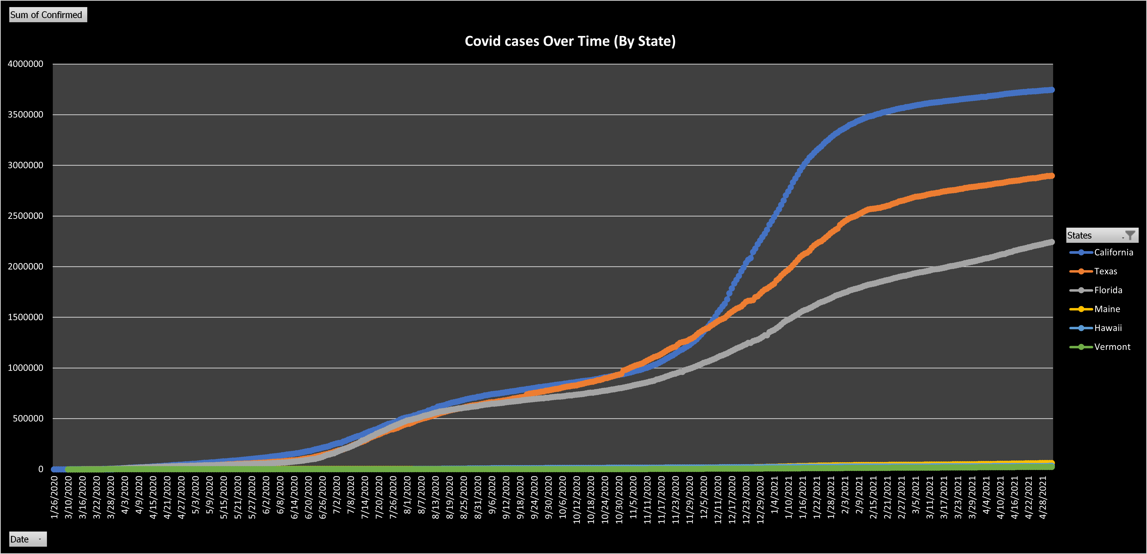

Slide 8
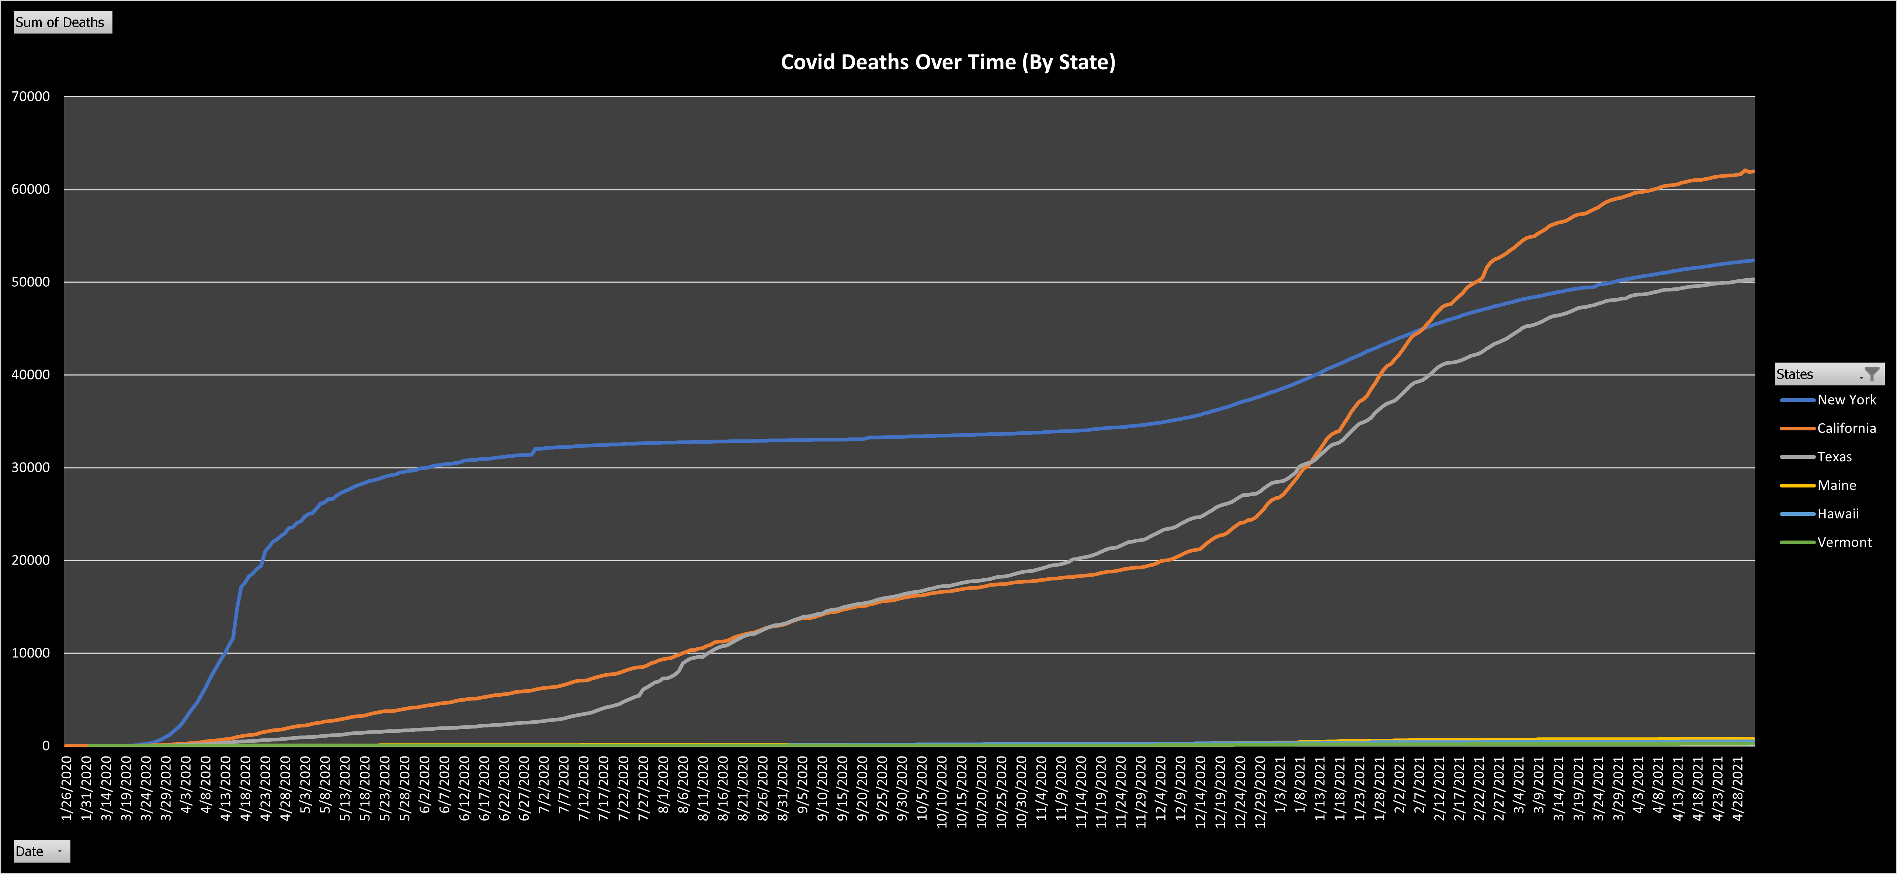

Slide 9
Covid Cases/Deaths By Country

Slide 10
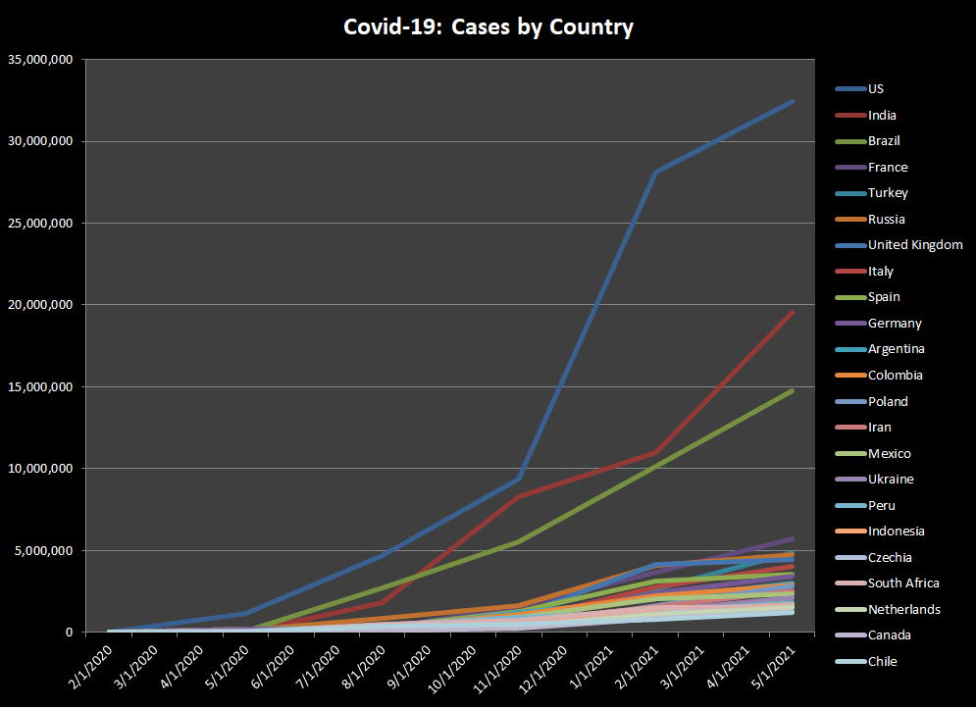

Slide 11
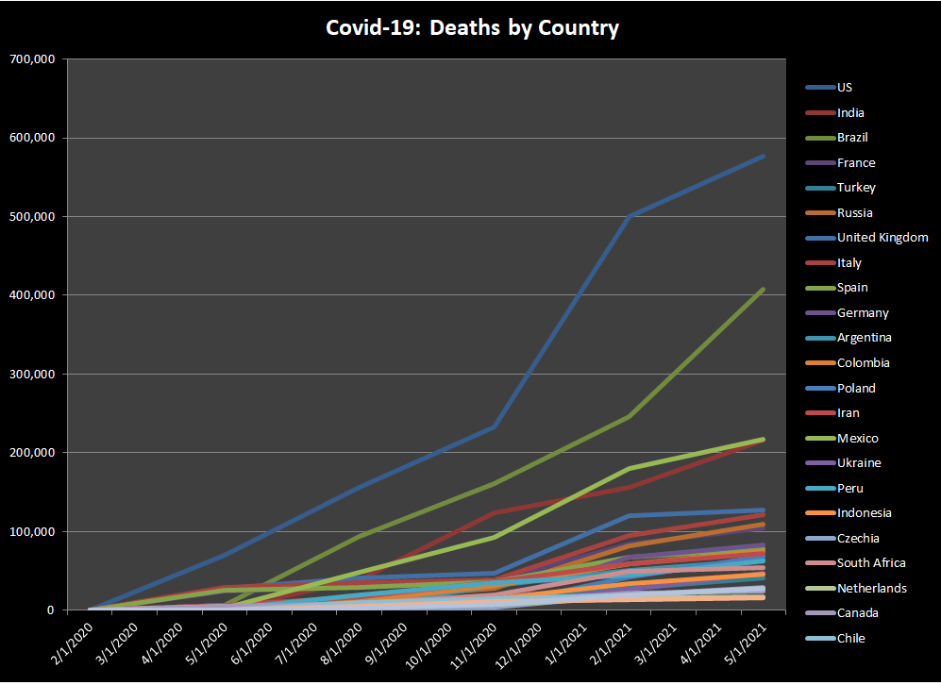

Slide 12
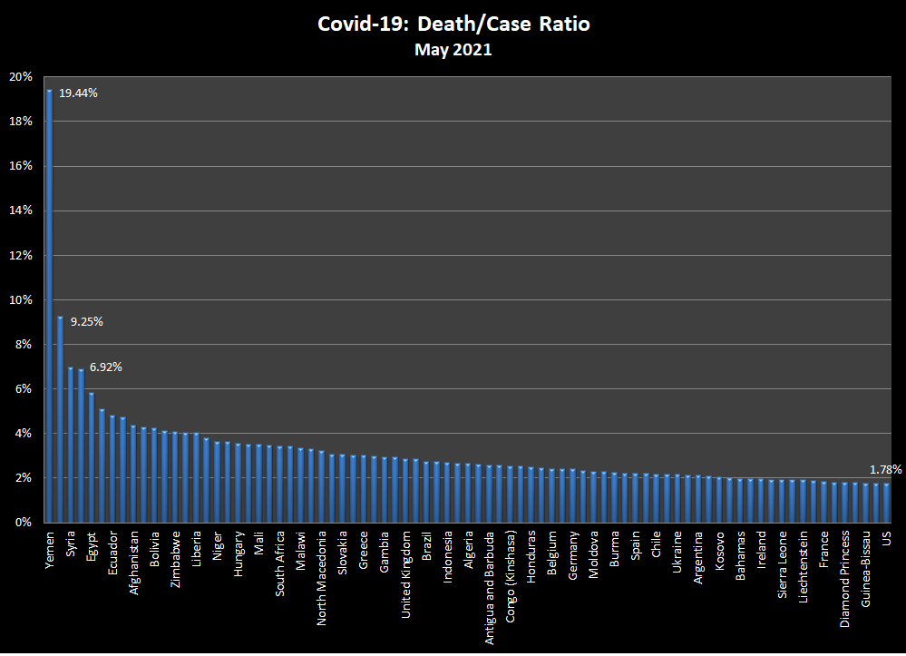

Slide 13
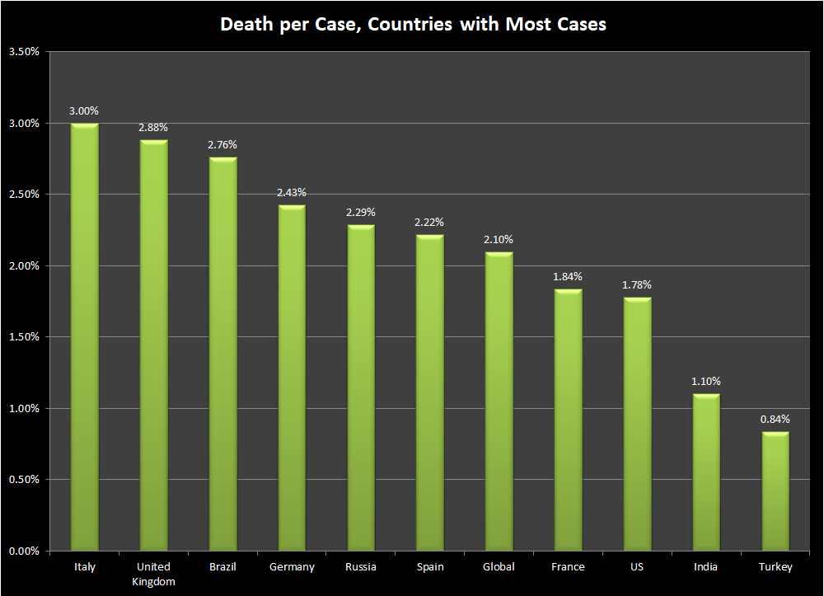

Slide 14
Covid Cases/Deaths by Population

Slide 15
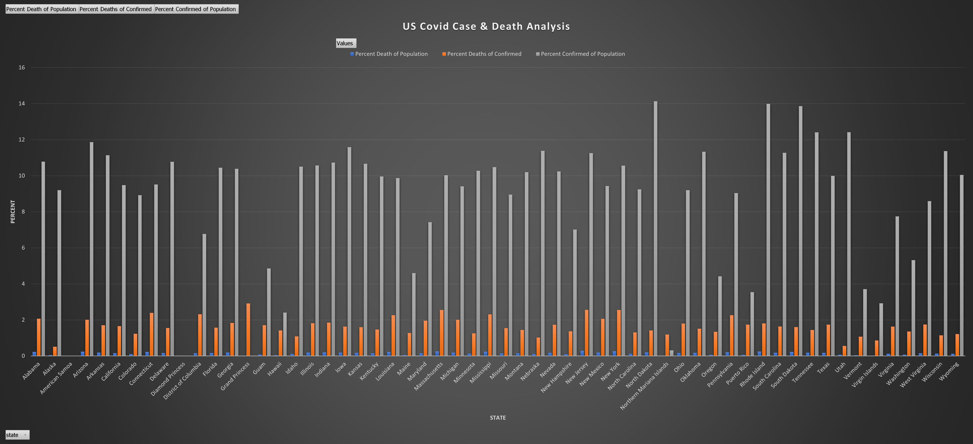

Slide 16
Things We Found

